Slide 1

ECommerce Purchase Prediction Using Machine Learning
Team Members
Sushanth Reddy Sandadi
Hari shankar k
Gvs navneeth
Sai Srinivas teja rupa

Slide 2
Before we begin , our project is a concept of supervised learning
And our task focuses on classification.

Slide 3
Introduction
Ecommerce has been one such congregation of technologies and processes which allow commerce to happen in an online form.
The online form has allowed for faster transactions, greater selection, and better customer support.
All these conveniences have been beneficial for the customers at large.
The COVID-19 pandemic resulted in an increased demand for doing business via the Internet.
This has resulted in a search for tools and techniques for better prediction of sales and new marketing strategies by managers of retail firms.

Slide 4
TASK / Proposal
The project intends to train machine learning models to predict whether a customer will buy a certain type of product listed on an eCommerce website or not.
The models will help websites designer to create better sales strategies i.e., offering discounts and offers to customers while they are browsing for products in real-time.
To do this, we will rely on session and visitor information and several other attributes in the dataset used against various machine learning techniques to reach the target audience, offering them the most relevant products for purchase.

Slide 5
About The DATASET
There are 12330 sessions that have been complied with.(https://archive.ics.uci.edu/ml/datasets/Online+Shoppers+Purchasing+Intention+Dataset)
Each session’s data has been added after the closing of the session.
Dataset was made such that each session belongs to a different user in a 1-year period. Of the 12330 sessions in the dataset, 84.5% (10422) were negative class samples that did not end with shopping and the rest (1908) were positive class samples ending with shopping.
The dataset consists of 10 numerical and 8 categorical attributes.

Slide 6
Administrative: Represents the number of administrative pages visited by the user in a session. Derived from URL information . (Integer value.)
Administrative Duration: Total time spent by the user on administrative pages during their session. Derived from user actions. (Integer value).
Informational: Indicates the number of informational pages visited by the user in a session.(Integer value)
Informational Duration: Total time spent by the user on informational pages during their session.(Integer value).
Product Related: Represents the number of pages related to products visited by the user in a session. (Integer value).
Product Related Duration: Total time spent by the user on product-related pages during their session. Derived from user actions and updated in real-time. (Continuous value).
Bounce Rates: Refers to the percentage of visitors who enter the site from a specific page and leave without any further interaction. (Continuous value).
Exit Rates: Indicates the percentage of visits to a specific page that were the last in the session. (Continuous value).
Page Values: Represents the average value for a webpage that a user visited before completing an e-commerce transaction. (Integer value).

Slide 7
Special Day: Indicates the proximity of the visit to a special day, affecting the likelihood of completing a transaction. Its value is determined based on e-commerce dynamics such as order and delivery dates. Integer value.
Month: Represents the month of the year in which the visit occurred. Categorical value.
Operating Systems: Indicates the operating system used by the visitor. Integer value.
Browser: Represents the web browser used by the visitor. Integer value.
Region: Indicates the geographical region of the visitor. Integer value.
Traffic Type: Represents the type of traffic source that brought the visitor to the website. Integer value.
Visitor Type: Indicates whether the visitor is a returning or new visitor. Categorical value.
Weekend: Boolean value indicating whether the visit occurred on a weekend.
Revenue: Binary attribute indicating whether the visit resulted in revenue generation for the website. This is the target attribute.
As discussed in the class, in those terms the Y for us or the target variable is “REVENUE” here and X would be all the other attributes/features in the dataset.

Slide 8
As mentioned before , the concept of supervised learning is put into use under which we plan on using methods like
Naïve bayes
Logistic regression
KNN
SVM
Random forests
Decision trees

Slide 9
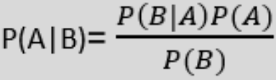
Naive Bayes classifier
Naive Bayes algorithm is a supervised learning algorithm, which is based on Bayes theorem and used for solving classification problems.
Bayes theorem:
Gaussian : The Gaussian model assumes that features follow a normal distribution. This means if predictors take continuous values instead of discrete, then the model assumes that these values are sampled from the Gaussian distribution.

Slide 10
Logistic Regression Model
Its an algorithm which has the ability to provide probabilities and classify new data using continuous and discrete datasets.
It predicts the output of a categorical dependent variable. Therefore the outcome must be a categorical or discrete value
but instead of giving the exact value as 0 and 1, it gives the probabilistic values which lie between 0 and 1.

Slide 11
Decision Tree Model
can be used for both classification and Regression problems, but mostly it is preferred for solving Classification problems.
It is a tree-structured classifier,
where internal nodes represent the features of a dataset, branches represent the decision rules and each leaf node represents the outcome.
It is a graphical representation for getting all the possible solutions to a problem/decision based on given conditions.

Slide 12
Random Forest Model
It is based on the concept of ensemble learning, which is a process of combining multiple classifiers to solve a complex problem and to improve the performance of the model.
Instead of relying on one decision tree, the random forest takes the prediction from each tree and based on the majority votes of predictions, and it predicts the final output.
It predicts output with high accuracy, even for the large dataset it runs efficiently.

Slide 13
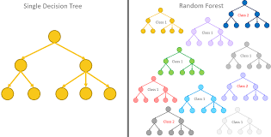

Slide 14
K-Nearest Neighbor(KNN)
K-NN algorithm assumes the similarity between the new data and available cases and put the new case into the category that is most similar to the available categories.
K-NN algorithm stores all the available data and classifies a new data point based on the similarity.
This means when new data appears then it can be easily classified into a well suite category by using K- NN algorithm.

Slide 15
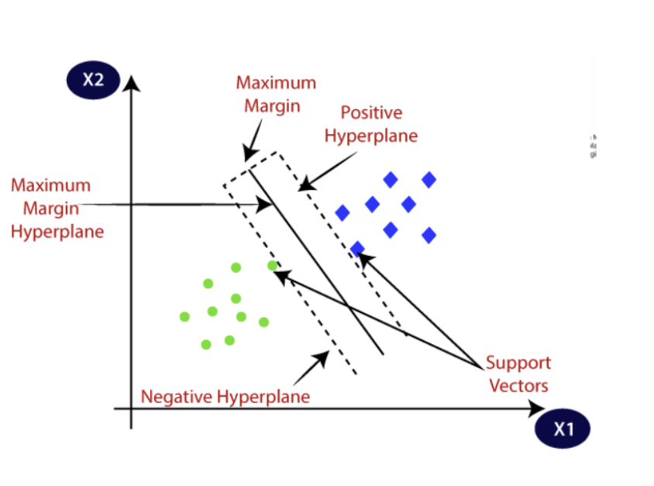
Support vector machines (SVM)
SVM algorithm is to create the best line or decision boundary that can segregate n-dimensional space into classes so that we can easily put the new data point in the correct category in the future.
This best decision boundary is called a hyperplane.
SVM chooses the extreme points/vectors that help in creating the hyperplane.
These extreme cases are called as support vectors, and hence algorithm is termed as Support Vector Machine.

Slide 16
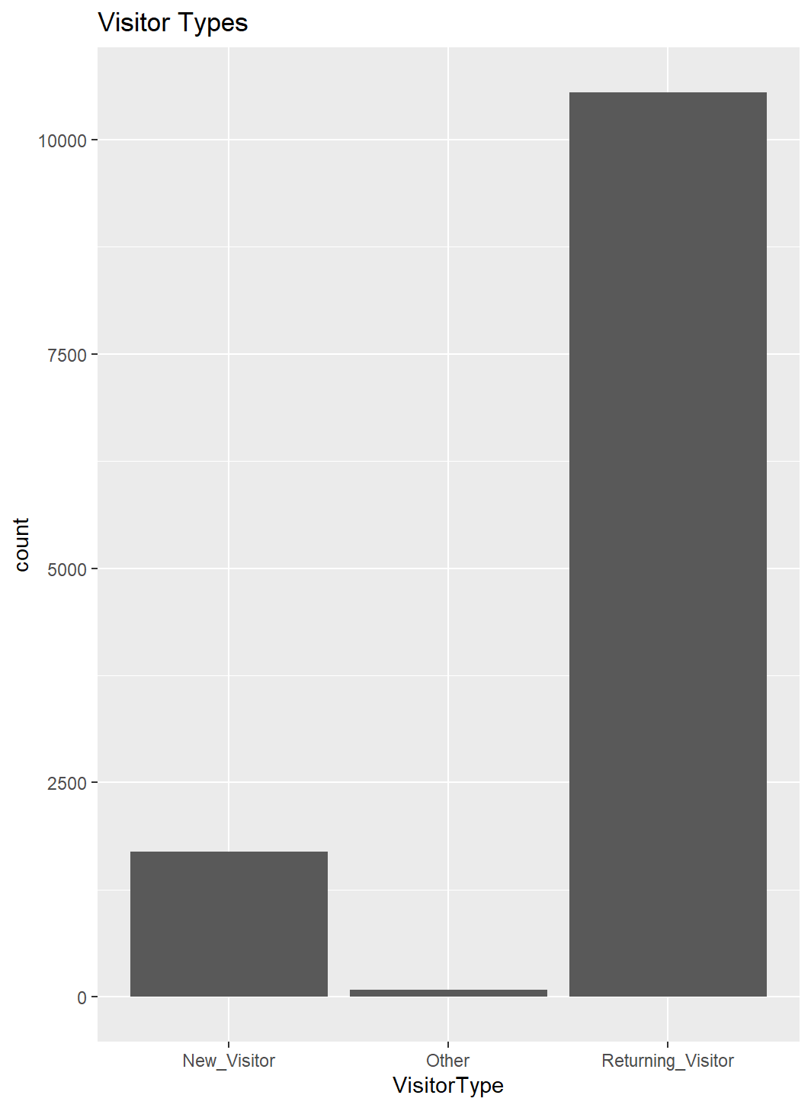
Work flow
Data Loading
Data Preprocessing
Model Training and Evaluation
ROC Curve Analysis
Handling Class Imbalance
Comparing the result

Slide 17
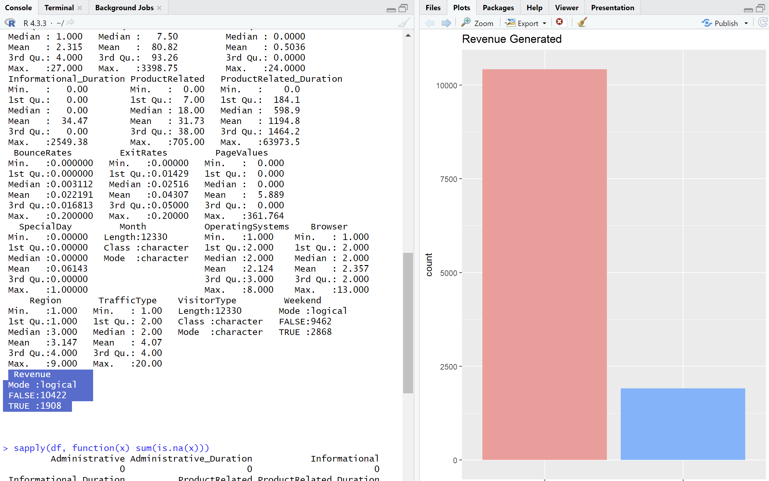
Addressing the imbalance in the data set
As discussed above , in the dataset, 84.5% (10422) were negative class samples that did not end with shopping and the rest (1908) were positive class samples ending with shopping
To address the imbalance in the dataset ,
We have used techniques like –
SMOTE
Near miss (nr)
To perform on Under sampled dataset and
Oversampled dataset hence addressing the class imbalance in the dataset. Models are trained and evaluated again on the balanced datasets, and ROC curves are plotted for comparison.

Slide 18
Evaluation metrics
For the purpose of calculation we have gone through all of these –
Accuracy Score
Confusion Matrix
Sensitivity (True Positive Rate) and Specificity (True Negative Rate
False Positive Rate (FPR) and False Negative Rate (FNR)
F1 score
All of these are the parameters we used for comparison

Slide 19
CODE and the Results – (switching to R-studio)

Slide 20
Result comparison

Slide 21
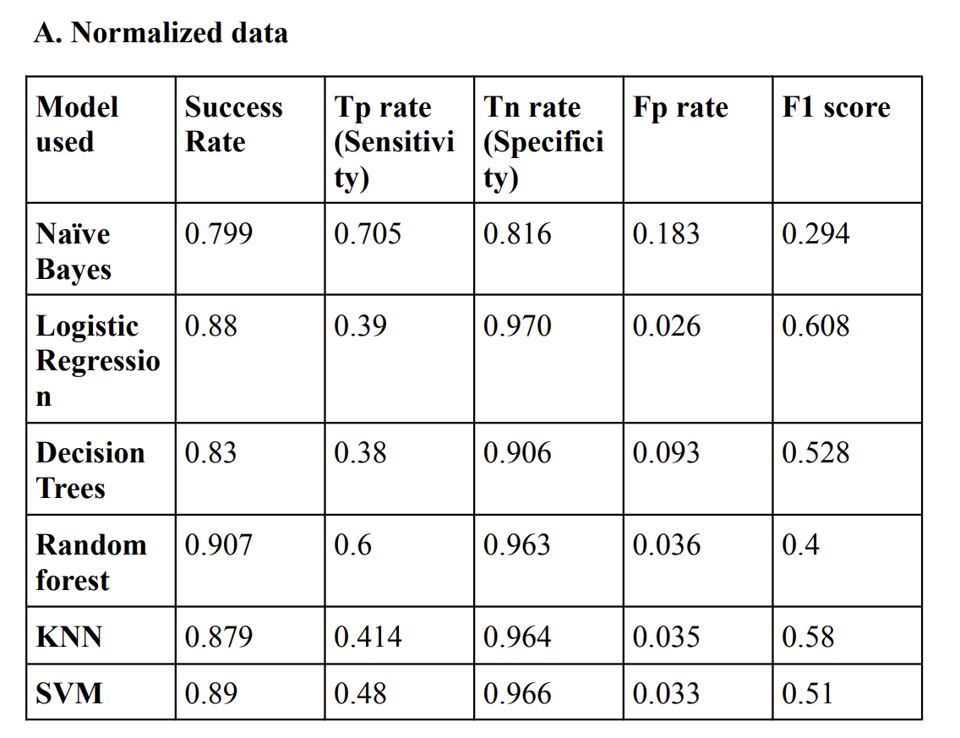

Slide 22
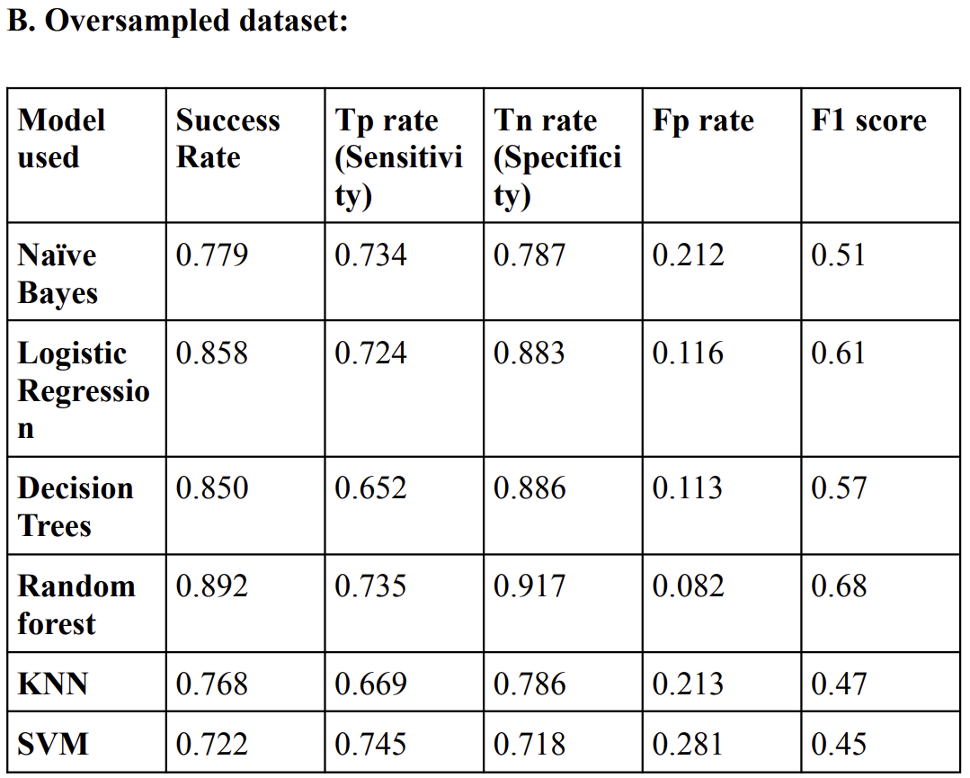

Slide 23
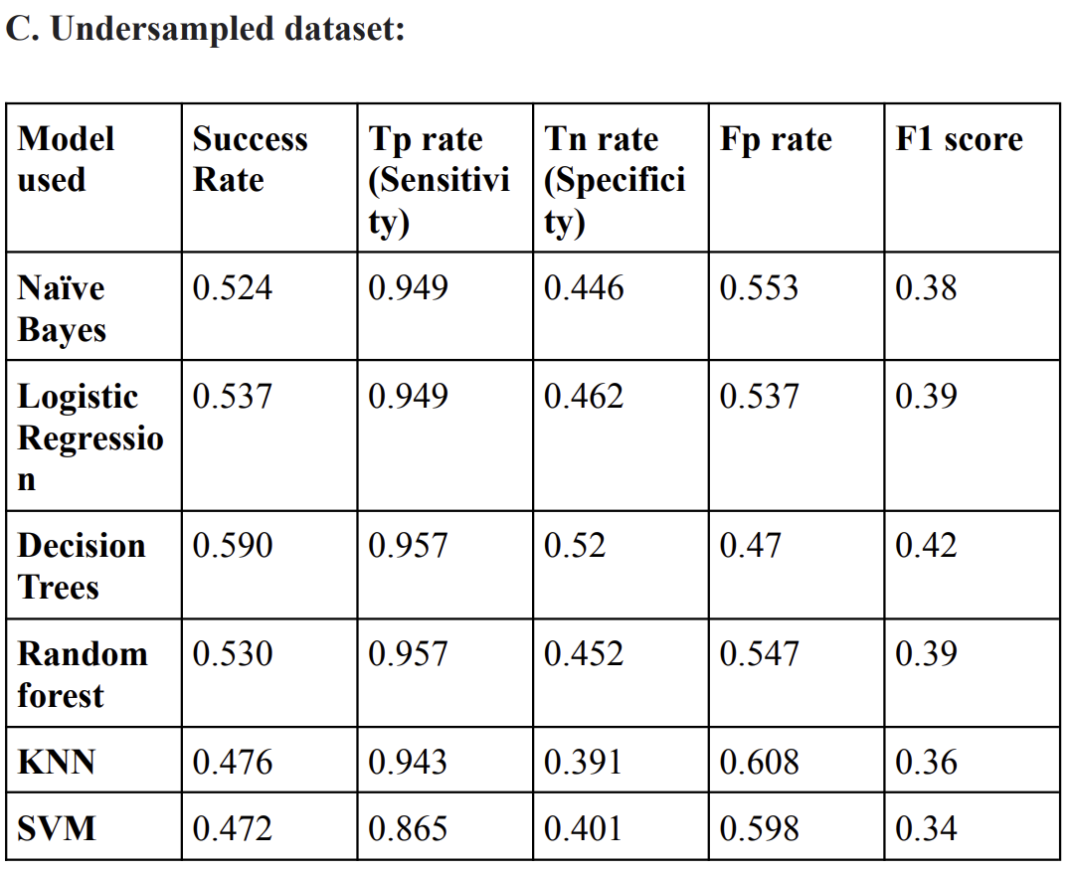

Slide 24
Conclusion
Our analysis aimed to evaluate various classification models for predicting online shoppers' intention.
We found that while all models showed promise in predicting online shoppers' behavior, some performed better than others across different evaluation metrics.
Handling class imbalance using SMOTE and NearMiss, had a notable impact on model performance.
Our findings suggest that a combination of data preprocessing techniques and careful selection of classification algorithms can significantly improve the accuracy and reliability of predicting online shoppers' intention.

Slide 25
Limitations -
While our analysis provides valuable insights into predicting online shoppers' intention, it is important to acknowledge some limitations.
The dataset may not capture all relevant features influencing online shopping behavior, and further exploration with additional data sources could enhance model performance.
Irrespective of what has been done there are factors which cant be accounted in those cases the models which fail

Slide 26
References
1. https://www.mbaknol.com/marketing-management/the-engel-kollat-blackwell-model-of-consumer-behavior/
2.https://www.emerald.com/insight/content/doi/10.1108/03090560910976410/full/pdf?title=shopping-orientation-and-online-clothing-purchases-the-role-of-gender-and-purchase-situation
3. https://www.ukessays.com/essays/marketing/literature-review-of-online-purchase-intention-marketing-essay.php
4.

Slide 27
Contributes
Sushanth Reddy Sandadi - Code and Implementation
Hari shankar k - Presentation and Data Evaluation
Gvs navneeth - Final Report and research
Sai Srinivas teja rupa - Re Implementation of Codes on the scaled data using techinques smote and nr
Overall all , we have all contributed equally towards the project

Slide 28
Thank You !!!

